Slide 1
Graphics Cards
Advanced Graphics Programming

Slide 2

What is a graphics card?
A graphics card is a piece of computer hardware that produces the images we can see on a display.
Through them, we convert data into a format that a monitor understand.
The better the graphics card, the faster and smoother applications will run.
Games
Visualizers
Simulators

Slide 3
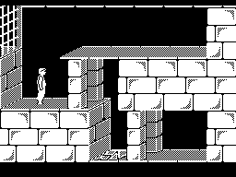
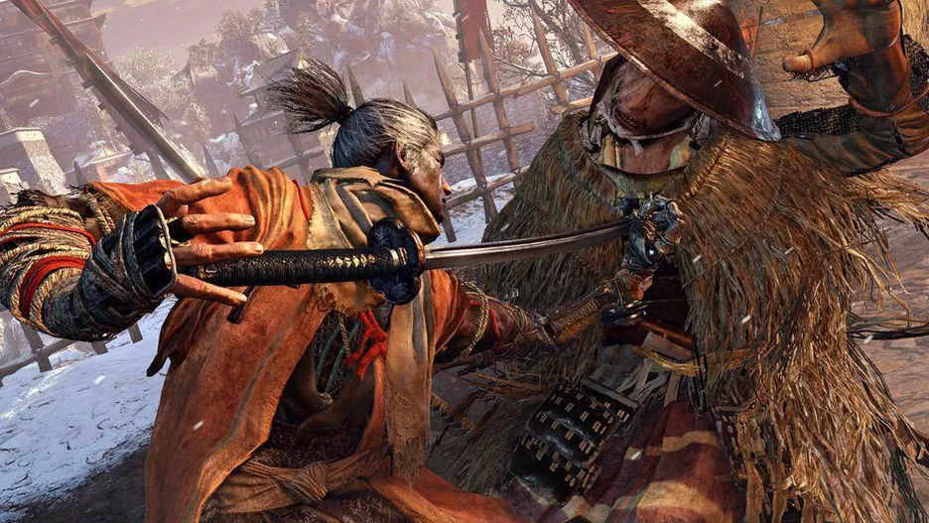
What is a graphics card?
Basically, in the last years, graphics cards have allowed moving from a to b
a
b

Slide 4
Brief history of graphics cards

Slide 5
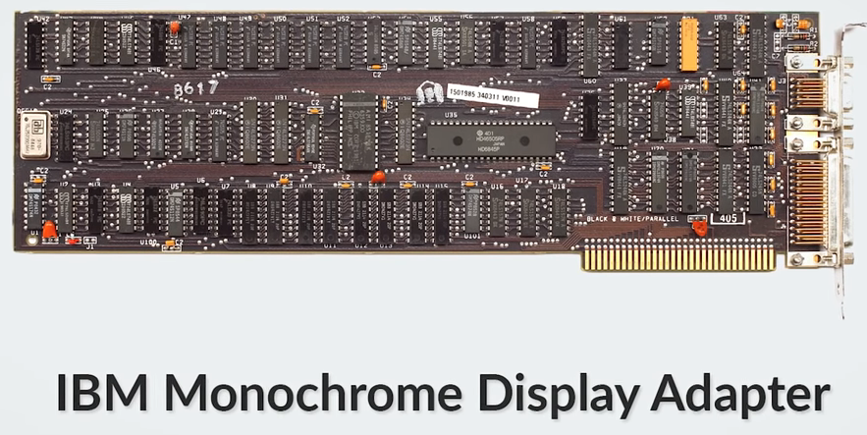
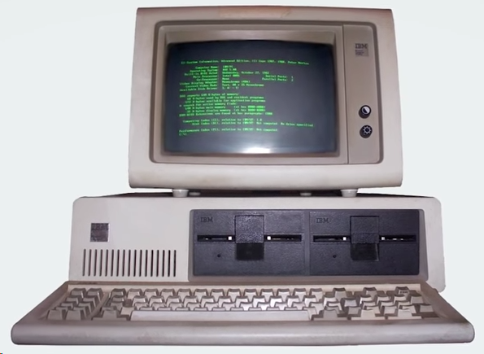
Brief history of graphics cards
1981
4kB of video memory
80 x 25 characters

Slide 6

Brief history of graphics cards
In 1985, three Hong Kong immigrants in Canada formed Array Technology Inc, soon renamed as ATI Technologies. This company would lead the market for years with its Wonder line of graphics boards and chips.

Slide 7
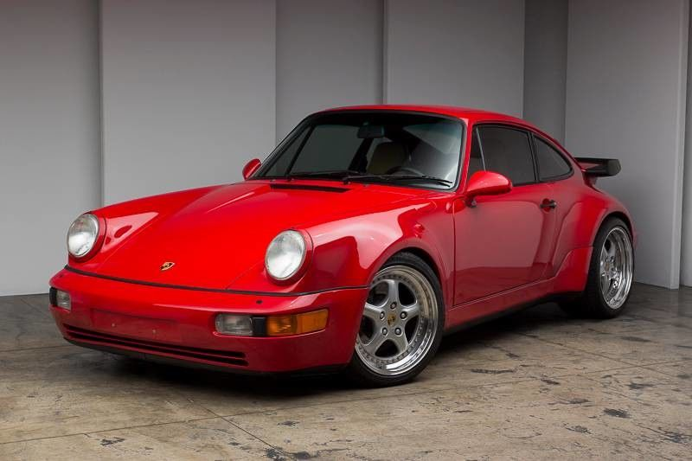
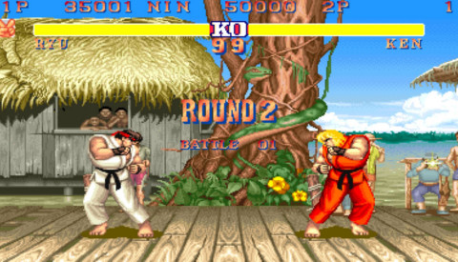
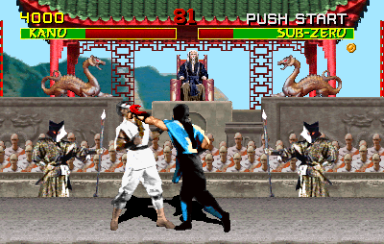
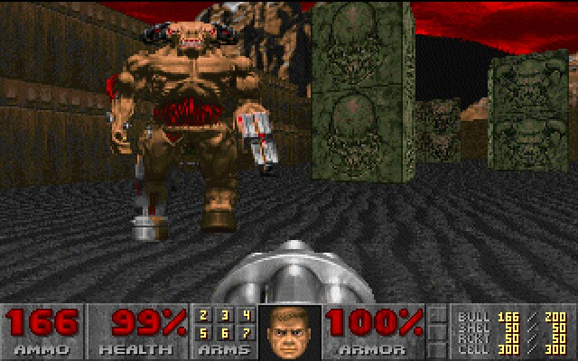
Brief history of graphics cards
In 1991 S3 Graphics introduced the S3 86C911.
Named after the Porsche 911.
This card spawned a crowd of imitators:
By 1995, major players in the making of graphics cards had added 2D acceleration.
Improved level of integration with the additional application programming interfaces (APIs).

Slide 8
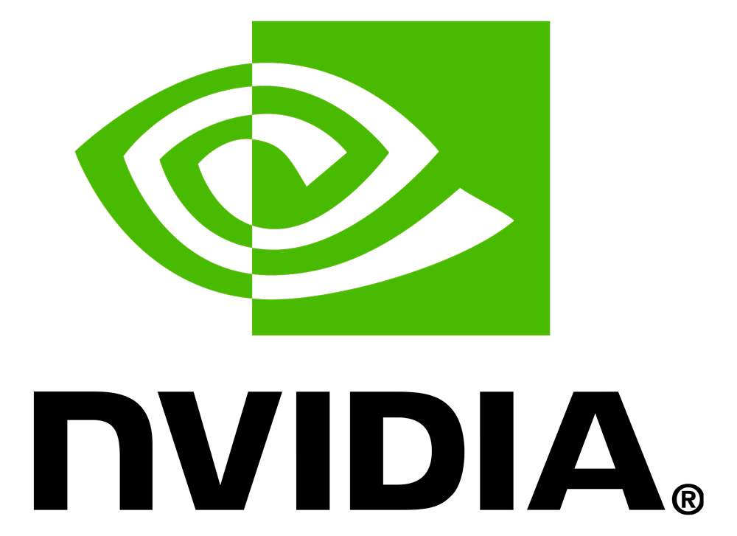
Brief history of graphics cards
Also, in the early 1990s
A lot of new graphics hardware companies.
NVIDIA was one of them.
By the end of 1997 it had nearly 25 % of the graphics market.

Slide 9
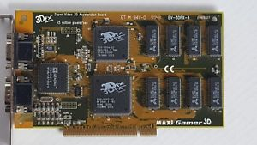
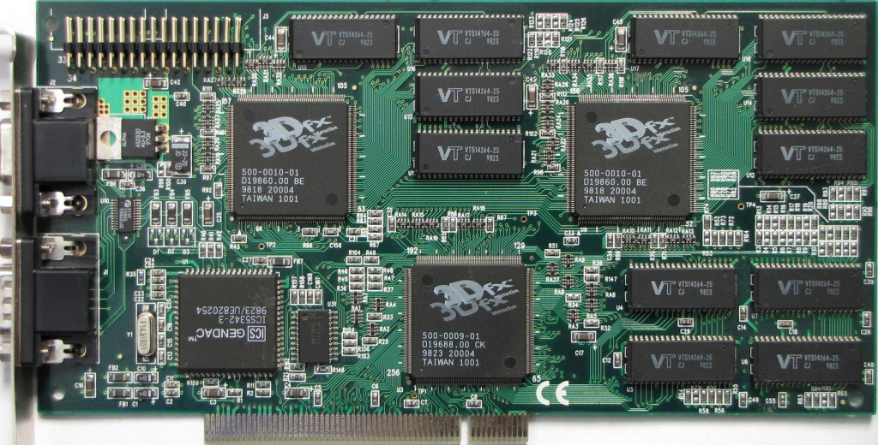
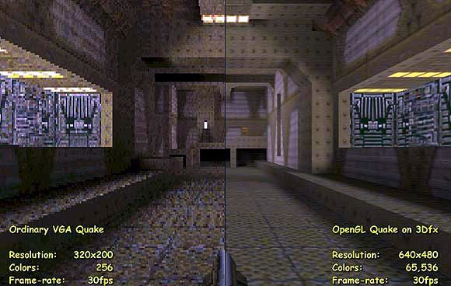
Brief history of graphics cards
3D Revolution (1995 - 2006)
First 3D add-in cards
More affordable PCs (before non-PC)
More affordable hardware
3dfx Voodoo (1996)
Only 3D (users needed a separated 2D card)
Anyways… it took 85 % of the market
3dfx Voodoo 2 (1998)

Slide 10
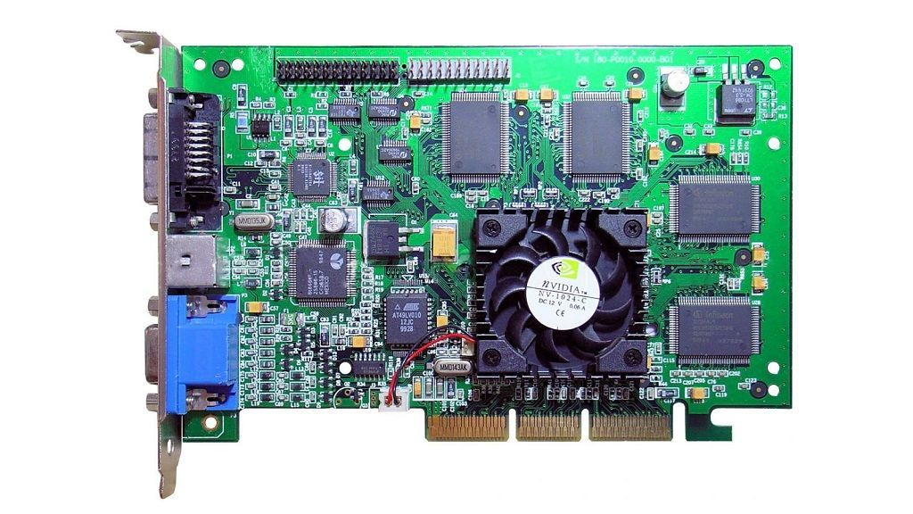
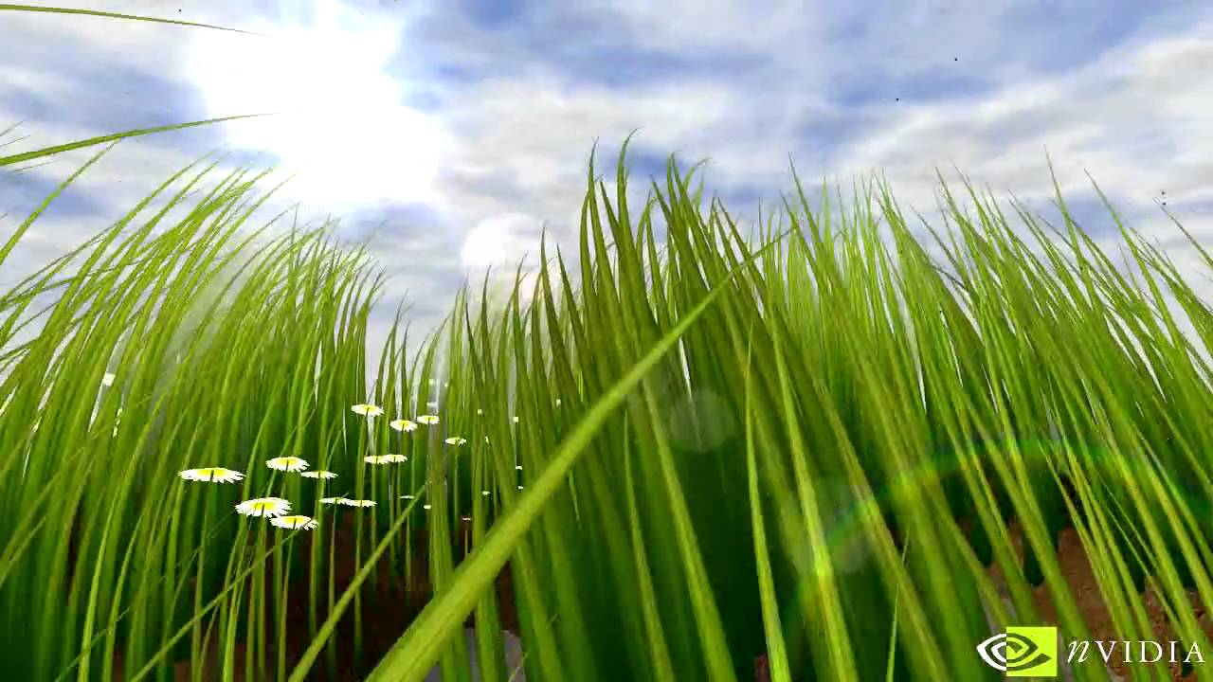
Brief history of graphics cards
1999
Nvidia GeForce 256
World’s first GPU
Nvidia defined graphics processing unit:
Single-chip processor with integrated transform, lighting, triangle setup/clipping, and rendering engines
10 million polygons/second
Grass demo

Slide 11

Brief history of graphics cards
2000 - 2006
Rivalry between ATI and Nvidia
Each company delivered newer and newer graphics features
At the same time, each new product adapted to the existing improvements
Features became commonplace

Slide 12




Brief history of graphics cards
2006 - present day
Not only for graphics
Era of general purpose GPUs (GPGPU)
Cuda (2007)
OpenCL (2009)
Besides graphics
Machine learning
Scientific data processing
Data mining
Statistics, linear algebra...

Slide 13
Technical aspects

Slide 14
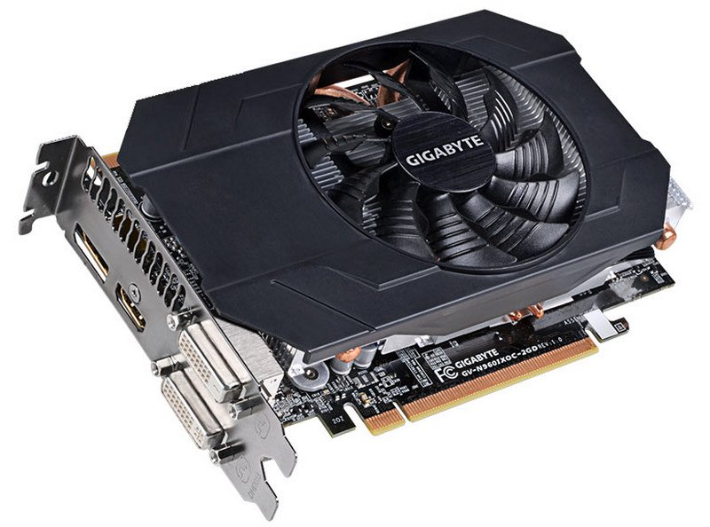
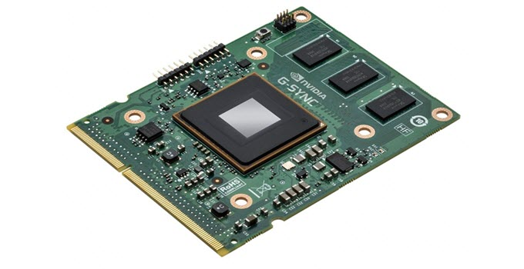
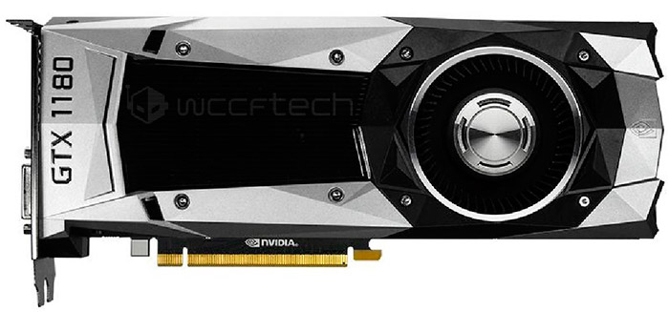
Types of graphics cards
Integrated
On-board cards
Laptops
Office work
Discrete
Additional hardware piece
High-performance applications (games)
GeForce GTX 960 (~ 150€)
Laptop graphics card
GeForce GTX 1180 (> 1000€)

Slide 15
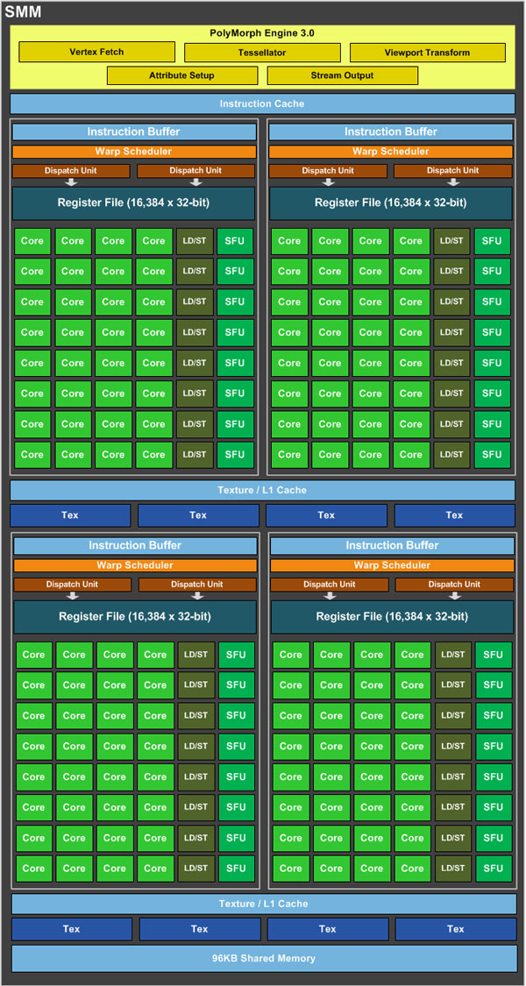
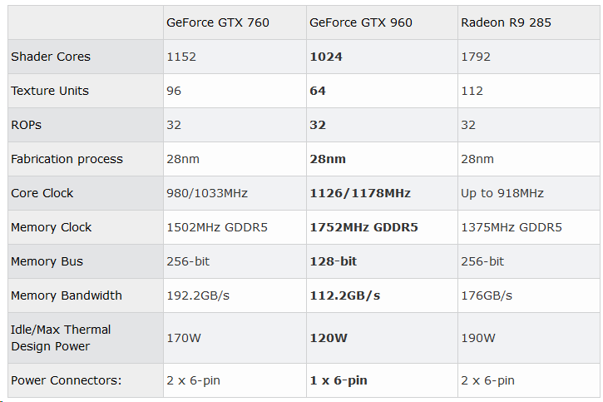
This is only a small part of the components of a GPU
High level of parallelism
High clock frequencies
High memory bandwidths
Prefer bandwidth over memory size

Slide 16
Main components
Graphics processing unit (GPU)
Data transformations:
Coordinate transformations
Clipping
Color computations
Algorithms...
Nothing that couldn’t be done by the CPU, but…
For millions of pixels at high frame rates!
Memory unit (video memory)
Data storage:
Buffers of vertex attributes:
Location
Texture coordinates
Surface normals...
Buffers of pixels:
Albedo textures
Normal maps
Environment maps...

